Slide 1
CSC D70:
Compiler Optimization
Prefetching
Prof. Gennady Pekhimenko
University of Toronto
Winter 2018
The content of this lecture is adapted from the lectures of
Todd Mowry and Phillip Gibbons

Slide 2
The Memory Latency Problem
↑ processor speed >> ↑ memory speed
caches are not a panacea

Slide 3
Prefetching for Arrays: Overview
Tolerating Memory Latency
Prefetching Compiler Algorithm and Results
Implications of These Results

Slide 4
Coping with Memory Latency
Reduce Latency:
  Locality Optimizations
    reorder iterations to improve cache reuse
Tolerate Latency:
  Prefetching
    move data close to the processor before it is needed

Slide 5
Tolerating Latency Through Prefetching
Without Prefetching
With Prefetching
Prefetch A
Time
Prefetch B
Fetch A
Fetch B
Load A
Load A
Load B
Fetch A
Load B
Fetch B
Executing Instructions
Stalled Waiting for Data
overlap memory accesses with computation and other accesses

Slide 6
Types of Prefetching
Cache Blocks:
(-) limited to unit-stride accesses
Nonblocking Loads:
(-) limited ability to move back before use
Hardware-Controlled Prefetching:
(-) limited to constant-strides and by branch prediction
(+) no instruction overhead
Software-Controlled Prefetching:
(-) software sophistication and overhead
(+) minimal hardware support and broader coverage

Slide 7
Prefetching Goals
Domain of Applicability
Performance Improvement
  maximize benefit
  minimize overhead

Slide 8
Prefetching Concepts
possible only if addresses can be determined ahead of time
coverage factor = fraction of misses that are prefetched
unnecessary if data is already in the cache
effective if data is in the cache when later referenced
Analysis: what to prefetch
  maximize coverage factor
  minimize unnecessary prefetches
Scheduling: when/how to schedule prefetches
  maximize effectiveness
  minimize overhead per prefetch

Slide 9
Reducing Prefetching Overhead
instructions to issue prefetches
extra demands on memory system
important to minimize unnecessary prefetches
Hit Rates for Array Accesses

Slide 10
Compiler Algorithm
Analysis: what to prefetch
Locality Analysis
Scheduling: when/how to issue prefetches
Loop Splitting
Software Pipelining

Slide 11
Steps in Locality Analysis
1. Find data reuse
  if caches were infinitely large, we would be finished
2. Determine “localized iteration space”
  set of inner loops where the data accessed by an iteration is expected to fit within the cache
3. Find data locality:
  reuse ∩ localized iteration space ⇒ locality

Slide 12
Data Locality Example
for i = 0 to 2
for j = 0 to 100
A[i][j] = B[j][0] + B[j+1][0];
Hit
Miss
A[i][j]
B[j+1][0]
B[j][0]
i
i
i
j
j
j
Spatial
Temporal
Group

Slide 13
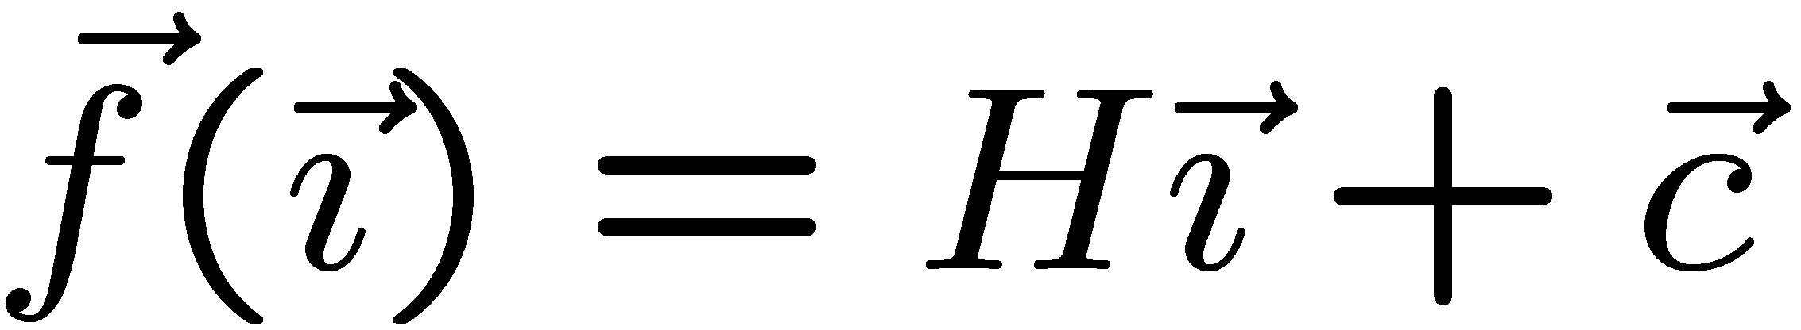
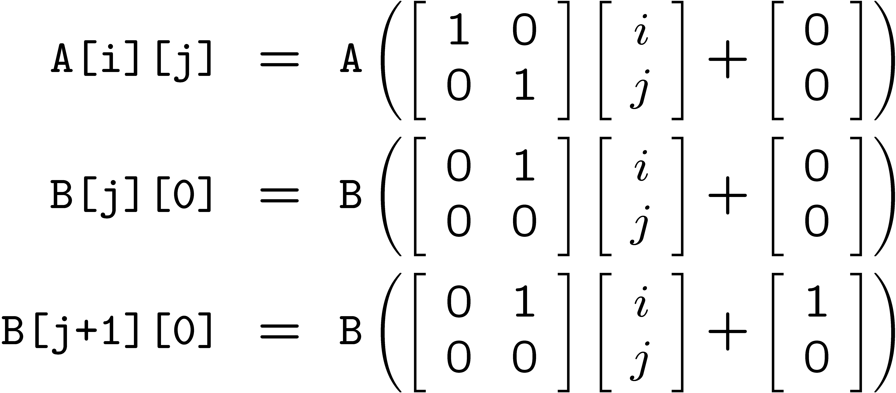
Reuse Analysis: Representation
for i = 0 to 2
for j = 0 to 100
A[i][j] = B[j][0] + B[j+1][0];
Map n loop indices into d array indices via array indexing function:

Slide 14
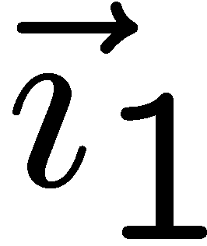
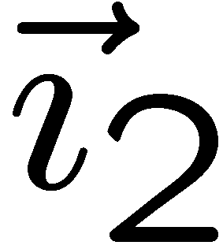
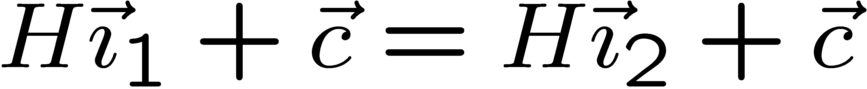
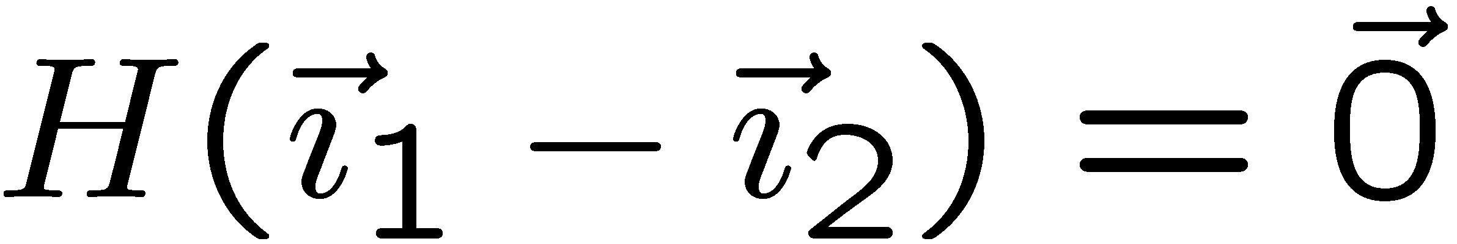

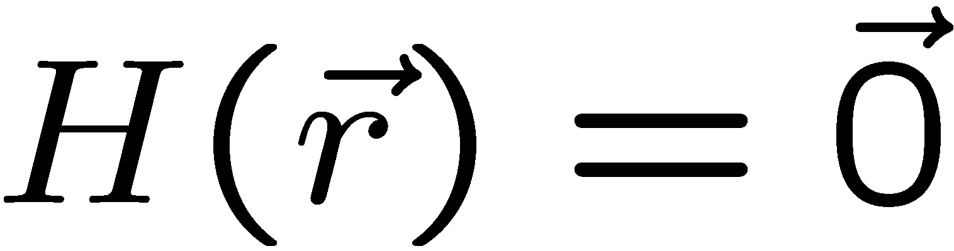
Finding Temporal Reuse
Temporal reuse occurs between iterations and whenever:
Rather than worrying about individual values of and, we say that reuse occurs along direction vector when:
Solution: compute the nullspace of H

Slide 15
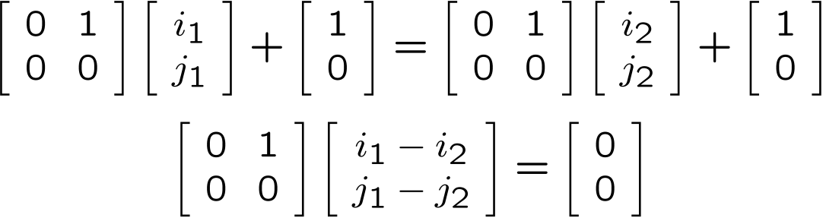
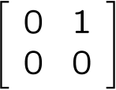
Temporal Reuse Example
for i = 0 to 2
for j = 0 to 100
A[i][j] = B[j][0] + B[j+1][0];
Reuse between iterations (i₁,j₁) and (i₂,j₂) whenever:
True whenever j₁ = j₂, and regardless of the difference between i₁ and i₂.
  i.e. whenever the difference lies along the nullspace of ,
  which is span{(1,0)} (i.e. the outer loop).

Slide 16
Prefetch Predicate
Locality Type | Miss Instance | Predicate
None | Every Iteration | True
Temporal | First Iteration | i = 0
Spatial | Every l iterations (l = cache line size) | (i mod l) = 0
Example:
for i = 0 to 2
for j = 0 to 100
A[i][j] = B[j][0] + B[j+1][0];
Reference | Locality | Predicate
A[i][j] |  | (j mod 2) = 0
B[j+1][0] |  | i = 0
[
]
[
]
i
j
=
none
spatial
[
]
[
]
i
j
=
temporal
none

Slide 17
Compiler Algorithm
Analysis: what to prefetch
Locality Analysis
Scheduling: when/how to issue prefetches
Loop Splitting
Software Pipelining

Slide 18
Loop Splitting
Decompose loops to isolate cache miss instances
  cheaper than inserting IF statements
Apply transformations recursively for nested loops
Suppress transformations when loops become too large
  avoid code explosion
Locality Type | Predicate | Loop Transformation
None | True | None
Temporal | i = 0 | Peel loop i
Spatial | (i mod l) = 0 | Unroll loop i by l

Slide 19
Software Pipelining
l
Iterations Ahead = ⎡ ⎤
s
where l = memory latency, s = shortest path through loop body
Original Loop
Software Pipelined Loop
(5 iterations ahead)
for (i = 0; i<100; i++)
a[i] = 0;
for (i = 0; i<5; i++) /* Prolog */
prefetch(&a[i]);
for (i = 0; i<95; i++) { /* Steady State*/
prefetch(&a[i+5]);
a[i] = 0;
}
for (i = 95; i<100; i++) /* Epilog */
a[i] = 0;

Slide 20
Example Revisited
Original Code
Code with Prefetching
for (i = 0; i < 3; i++)
for (j = 0; j < 100; j++)
A[i][j] = B[j][0] + B[j+1][0];
prefetch(&A[0][0]);
for (j = 0; j < 6; j += 2) {
prefetch(&B[j+1][0]);
prefetch(&B[j+2][0]);
prefetch(&A[0][j+1]);
}
for (j = 0; j < 94; j += 2) {
prefetch(&B[j+7][0]);
prefetch(&B[j+8][0]);
prefetch(&A[0][j+7]);
A[0][j] = B[j][0]+B[j+1][0];
A[0][j+1] = B[j+1][0]+B[j+2][0];
}
for (j = 94; j < 100; j += 2) {
A[0][j] = B[j][0]+B[j+1][0];
A[0][j+1] = B[j+1][0]+B[j+2][0];
}
for (i = 1; i < 3; i++) {
prefetch(&A[i][0]);
for (j = 0; j < 6; j += 2)
prefetch(&A[i][j+1]);
for (j = 0; j < 94; j += 2) {
prefetch(&A[i][j+7]);
A[i][j] = B[j][0] + B[j+1][0];
A[i][j+1] = B[j+1][0] + B[j+2][0];
}
for (j = 94; j < 100; j += 2) {
A[i][j] = B[j][0] + B[j+1][0];
A[i][j+1] = B[j+1][0] + B[j+2][0];
}
}
Cache Hit
Cache Miss
i = 0
A[i][j]
i
j
B[j+1][0]
i > 0
i
j

Slide 21
Prefetching Indirections
for (i = 0; i<100; i++)
sum += A[index[i]];
Analysis: what to prefetch
  both dense and indirect references
  difficult to predict whether indirections hit or miss
Scheduling: when/how to issue prefetches
  modification of software pipelining algorithm

Slide 22
Software Pipelining for Indirections
Software Pipelined Loop
(5 iterations ahead)
Original Loop
for (i = 0; i<100; i++)
sum += A[index[i]];
for (i = 0; i<5; i++) /* Prolog 1 */
prefetch(&index[i]);
for (i = 0; i<5; i++) { /* Prolog 2 */
prefetch(&index[i+5]);
prefetch(&A[index[i]]);
}
for (i = 0; i<90; i++) { /* Steady State*/
prefetch(&index[i+10]);
prefetch(&A[index[i+5]]);
sum += A[index[i]];
}
for (i = 90; i<95; i++) { /* Epilog 1 */
prefetch(&A[index[i+5]]);
sum += A[index[i]];
}
for (i = 95; i<100; i++) /* Epilog 2 */
sum += A[index[i]];

Slide 23
Summary of Results
Dense Matrix Code:
  eliminated 50% to 90% of memory stall time
  overheads remain low due to prefetching selectively
  significant improvements in overall performance (6 over 45%)
Indirections, Sparse Matrix Code:
  expanded coverage to handle some important cases

Slide 24
Prefetching for Arrays: Concluding Remarks
Demonstrated that software prefetching is effective
  selective prefetching to eliminate overhead
  dense matrices and indirections / sparse matrices
  uniprocessors and multiprocessors
Hardware should focus on providing sufficient memory bandwidth

Slide 25
Prefetching for Recursive Data Structures

Slide 26
Recursive Data Structures
Examples:
  linked lists, trees, graphs, ...
A common method of building large data structures
  especially in non-numeric programs
Cache miss behavior is a concern because:
  large data set with respect to the cache size
  temporal locality may be poor
  little spatial locality among consecutively-accessed nodes
Goal:
Automatic Compiler-Based Prefetching for Recursive Data Structures

Slide 27
Overview
Challenges in Prefetching Recursive Data Structures
Three Prefetching Algorithms
Experimental Results
Conclusions

Slide 28
Scheduling Prefetches for Recursive Data Structures
Our Goal: fully hide latency
  thus achieving fastest possible computation rate of 1/W
e.g., if L = 3W, we must prefetch 3 nodes ahead to achieve this

Slide 29
Performance without Prefetching
computation rate = 1 / (L+W)

Slide 30
Prefetching One Node Ahead
Computation is overlapped with memory accesses
computation rate = 1/L

Slide 31
Prefetching Three Nodes Ahead
computation rate does not improve (still = 1/L)!
Pointer-Chasing Problem:
any scheme which follows the pointer chain is limited to a rate of 1/L

Slide 32
Our Goal: Fully Hide Latency
achieves the fastest possible computation rate of 1/W

Slide 33
Overview
Challenges in Prefetching Recursive Data Structures
Three Prefetching Algorithms
  Greedy Prefetching
  History-Pointer Prefetching
  Data-Linearization Prefetching
Experimental Results
Conclusions

Slide 34
Pointer-Chasing Problem
Key:
n_{i} needs to know &n_{i+d} without referencing the d-1 intermediate nodes
Our proposals:
use existing pointer(s) in n_{i} to approximate &n_{i+d}
  Greedy Prefetching
add new pointer(s) to n_{i} to approximate &n_{i+d}
  History-Pointer Prefetching
compute &n_{i+d} directly from &n_{i} (no ptr deref)
  History-Pointer Prefetching

Slide 35
Greedy Prefetching
Prefetch all neighboring nodes (simplified definition)
  only one will be followed by the immediate control flow
  hopefully, we will visit other neighbors later
Reasonably effective in practice
However, little control over the prefetching distance
preorder(treeNode * t){
if (t != NULL){
pf(t->left);
pf(t->right);
process(t->data);
preorder(t->left);
preorder(t->right);
}
}

Slide 36
History-Pointer Prefetching
Add new pointer(s) to each node
  history-pointers are obtained from some recent traversal
Trade space & time for better control over prefetching distances

Slide 37
Data-Linearization Prefetching
No pointer dereferences are required
Map nodes close in the traversal to contiguous memory

Slide 38
Summary of Prefetching Algorithms
 | Greedy | History-Pointer | Data-Linearization
Control over Prefetching Distance | little | more precise | more precise
Applicability to Recursive Data Structures | any RDS | revisited; changes only slowly | must have a major traversal order; changes only slowly
Overhead in Preparing Prefetch Addresses | none | space + time | none in practice
Ease of Implementation | relatively straightforward | more difficult | more difficulty

Slide 39
Conclusions
Propose 3 schemes to overcome the pointer-chasing problem:
  Greedy Prefetching
  History-Pointer Prefetching
  Data-Linearization Prefetching
Automated greedy prefetching in SUIF
  improves performance significantly for half of Olden
  memory feedback can further reduce prefetch overhead
The other 2 schemes can outperform greedy in some situations

Slide 40
CSC D70:
Compiler Optimization
Parallelization
Prof. Gennady Pekhimenko
University of Toronto
Winter 2018
The content of this lecture is adapted from the lectures of
Todd Mowry and Tarek Abdelrahman

Slide 41
Data Dependence
We define four types of data dependence.
Flow (true) dependence: a statement S_{i} precedes a statement S_{j} in execution and S_{i} computes a data value that S_{j} uses.
Implies that S_{i} must execute before S_{j}.

Slide 42
Data Dependence
We define four types of data dependence.
Anti dependence: a statement S_{i} precedes a statement S_{j} in execution and S_{i} uses a data value that S_{j} computes.
It implies that S_{i} must be executed before S_{j}.

Slide 43
Data Dependence
We define four types of data dependence.
Output dependence: a statement S_{i} precedes a statement S_{j} in execution and S_{i} computes a data value that S_{j} also computes.
It implies that S_{i} must be executed before S_{j}.

Slide 44
Data Dependence
We define four types of data dependence.
Input dependence: a statement S_{i} precedes a statement S_{j} in execution and S_{i} uses a data value that S_{j} also uses.
Does this imply that S_{i} must execute before S_{j}?

Slide 45
Data Dependence (continued)
The dependence is said to flow from S_{i} to S_{j} because S_{i} precedes S_{j} in execution.
S_{i} is said to be the source of the dependence. S_{j} is said to be the sink of the dependence.
The only “true” dependence is flow dependence; it represents the flow of data in the program.
The other types of dependence are caused by programming style; they may be eliminated by re-naming.

Slide 46
Data Dependence (continued)
Data dependence in a program may be represented using a dependence graph G=(V,E), where the nodes V represent statements in the program and the directed edges E represent dependence relations.
S₁
δ^{t}
S₂
δº
δ^{α}
δ^{t}
S₃
δº
δ^{I}
S₄

Slide 47
Value or Location?
There are two ways a dependence is defined: value-oriented or location-oriented.

Slide 48
Example 1
i=2
i=3
i=4
do i = 2, 4
S₁: a(i) = b(i) + c(i)
S₂: d(i) = a(i)
end do
S₁[2]
S₂[2]
S₁[3]
S₂[3]
S₁[4]
S₂[4]
δ^{t}
δ^{t}
δ^{t}
a(2)
a(2)
a(3)
a(3)
a(4)
a(4)
There is an instance of S₁ that precedes an instance of S₂ in execution and S₁ produces data that S₂ consumes.
S₁ is the source of the dependence; S₂ is the sink of the dependence.
The dependence flows between instances of statements in the same iteration (loop-independent dependence).
The number of iterations between source and sink (dependence distance) is 0. The dependence direction is =.
or

Slide 49
Example 2
i=2
i=3
i=4
do i = 2, 4
S₁: a(i) = b(i) + c(i)
S₂: d(i) = a(i-1)
end do
S₁[2]
S₂[2]
S₁[3]
S₂[3]
S₁[4]
S₂[4]
a(2)
a(1)
a(3)
a(2)
a(4)
a(3)
δ^{t}
δ^{t}
There is an instance of S₁ that precedes an instance of S₂ in execution and S₁ produces data that S₂ consumes.
S₁ is the source of the dependence; S₂ is the sink of the dependence.
The dependence flows between instances of statements in different iterations (loop-carried dependence).
The dependence distance is 1. The direction is positive (<).
or

Slide 50
Example 3
i=2
i=3
i=4
do i = 2, 4
S₁: a(i) = b(i) + c(i)
S₂: d(i) = a(i+1)
end do
S₁[2]
S₂[2]
S₁[3]
S₂[3]
S₁[4]
S₂[4]
δª
δª
a(2)
a(3)
a(3)
a(4)
a(4)
a(5)
There is an instance of S₂ that precedes an instance of S₁ in execution and S₂ consumes data that S₁ produces.
S₂ is the source of the dependence; S₁ is the sink of the dependence.
The dependence is loop-carried.
The dependence distance is 1.
or
a
Are you sure you know why it is even though S₁ appears before S₂ in the code?
S
δ
S
2
<
1

Slide 51
Example 4
do i = 2, 4
do j = 2, 4
S: a(i,j) = a(i-1,j+1)
end do
end do
a(1,3)
a(1,4)
a(1,5)
S[2,2]
S[2,3]
S[2,4]
a(2,2)
δ^{t}
a(2,3)
δ^{t}
a(2,4)
An instance of S precedes another instance of S and S produces data that S consumes.
S is both source and sink.
The dependence is loop-carried.
The dependence distance is (1,-1).
a(2,3)
a(2,4)
a(2,5)
S[3,2]
S[3,3]
S[3,4]
a(3,2)
δ^{t}
a(3,3)
δ^{t}
a(3,4)
a(3,3)
a(3,4)
a(3,5)
S[4,2]
S[4,3]
S[4,4]
a(4,2)
a(4,3)
a(4,4)
or

Slide 52
Problem Formulation
Consider the following perfect nest of depth d:
array reference
subscript
position
subscript
function
or
subscript
expression

Slide 53
Problem Formulation
Dependence will exist if there exists two iteration vectors and such that and:
and
and
and
That is:
and
and
and

Slide 54
Problem Formulation - Example
do i = 2, 4
S₁: a(i) = b(i) + c(i)
S₂: d(i) = a(i-1)
end do
Does there exist two iteration vectors i₁ and i₂, such that
2 ≤ i₁ ≤ i₂ ≤ 4 and such that:
i₁ = i₂ -1?
Answer: yes; i₁=2 & i₂=3 and i₁=3 & i₂ =4.
Hence, there is dependence!
The dependence distance vector is i₂-i₁ = 1.
The dependence direction vector is sign(1) = <.

Slide 55
Problem Formulation - Example
do i = 2, 4
S₁: a(i) = b(i) + c(i)
S₂: d(i) = a(i+1)
end do
Does there exist two iteration vectors i₁ and i₂, such that
2 ≤ i₁ ≤ i₂ ≤ 4 and such that:
i₁ = i₂ +1?
Answer: yes; i₁=3 & i₂=2 and i₁=4 & i₂ =3. (But, but!).
Hence, there is dependence!
The dependence distance vector is i₂-i₁ = -1.
The dependence direction vector is sign(-1) = >.
Is this possible?

Slide 56
Problem Formulation - Example
do i = 1, 10
S₁: a(2*i) = b(i) + c(i)
S₂: d(i) = a(2*i+1)
end do
Does there exist two iteration vectors i₁ and i₂, such that
1 ≤ i₁ ≤ i₂ ≤ 10 and such that:
2*i₁ = 2*i₂ +1?
Answer: no; 2*i₁ is even & 2*i₂+1 is odd.
Hence, there is no dependence!

Slide 57
Problem Formulation
Dependence testing is equivalent to an integer linear programming (ILP) problem of 2d variables & m+d constraint!
An algorithm that determines if there exits two iteration vectors and that satisfies these constraints is called a dependence tester.
The dependence distance vector is given by .
The dependence direction vector is give by sign( ).
Dependence testing is NP-complete!
A dependence test that reports dependence only when there is dependence is said to be exact. Otherwise it is in-exact.
A dependence test must be conservative; if the existence of dependence cannot be ascertained, dependence must be assumed.
-
-

Slide 58
Dependence Testers
Lamport’s Test.
GCD Test.
Banerjee’s Inequalities.
Generalized GCD Test.
Power Test.
I-Test.
Omega Test.
Delta Test.
Stanford Test.
etc…

Slide 59
CSC D70:
Compiler Optimization
Parallelization
Prof. Gennady Pekhimenko
University of Toronto
Winter 2018
The content of this lecture is adapted from the lectures of
Todd Mowry and Tarek Abdelrahman

